Slide 1
ROBOTICS Project
Done by :
-Shriarulmozhivarman GOBICHETTIPALAYAM,
-Etinosa Matthew IKPONMWOSA
Supervised by :
Ralph SEULIN,
David FOFI,
Raphael DUVERNE,
Renato MARTINS,
Joaquin RODRIGUEZ.

Slide 2
Contents
Aim of the Project
Prior Knowledge
Sub-divisions of the Project
Implementation
Demo
Conclusions

Slide 3
Aim of the Project
The Aim of this project is to Demonstrate a Ground Robot performing Autonomous Driving by Perception.

Slide 4
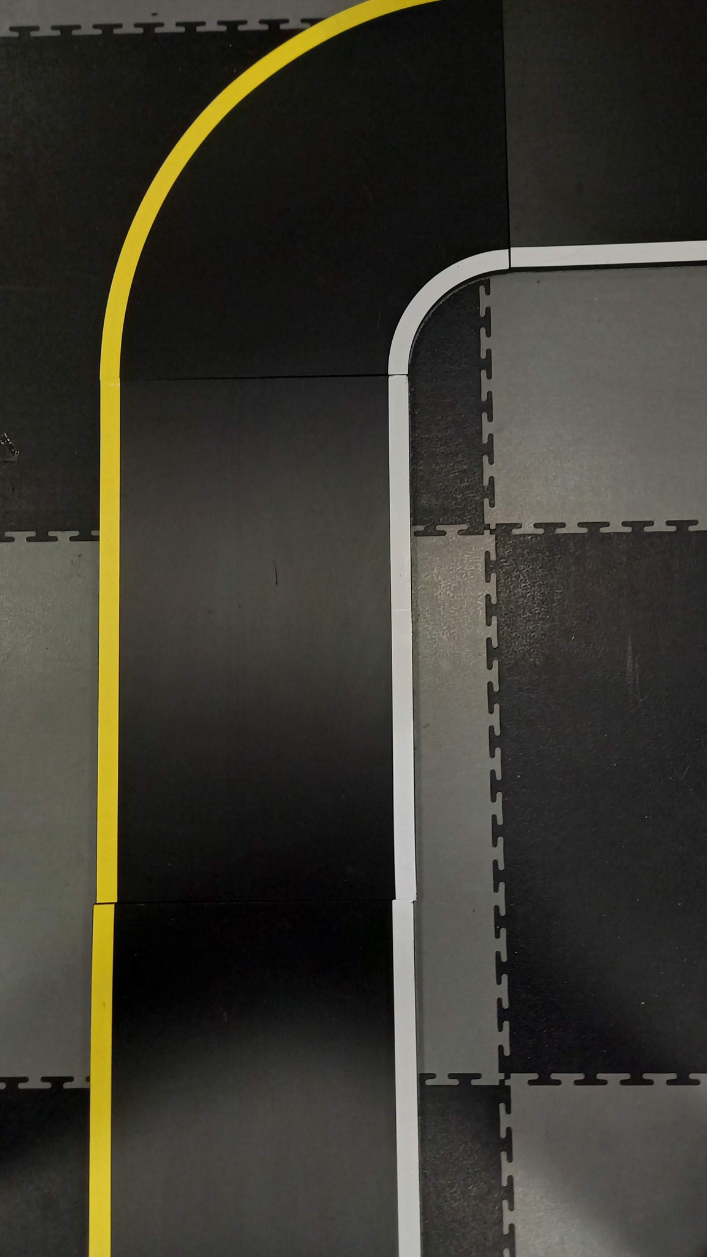
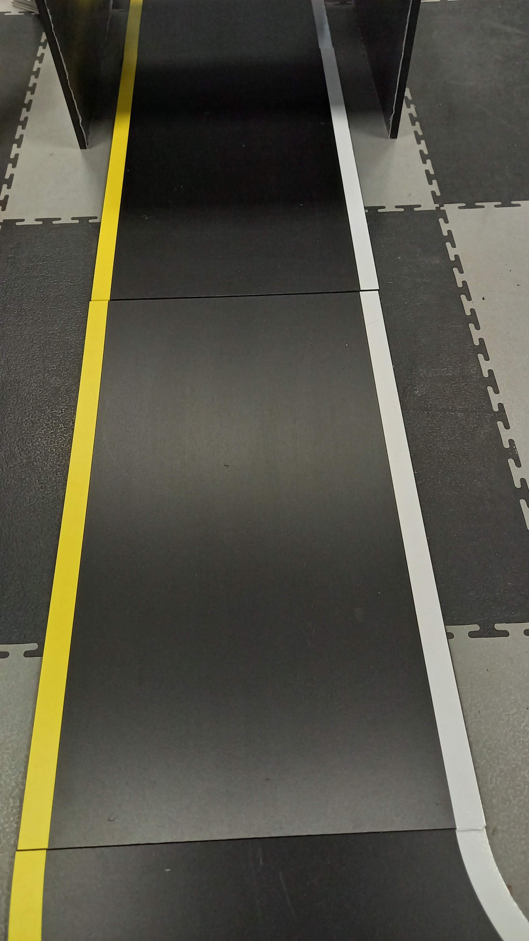
Prior Knowledge
The Robot has to follow the lanes with yellow on the left and white on the right and the distance between the lane remains almost constant throughout the track.
Photo of track at various parts of the track.

Slide 5
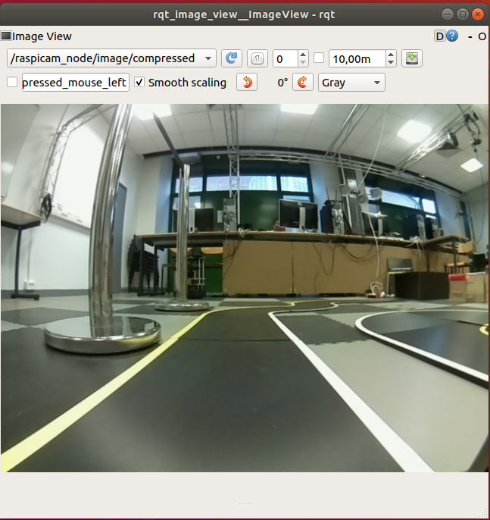
Sub-divisions to the Project
Get the image and apply filters to detect the lanes in the track.
Control the robot with the detected lanes.
Control the robot even when we have the one lane in the track.
Image from the robot’s camera
Notes:
ngfjngjnty

Slide 6
Implementation

Slide 7
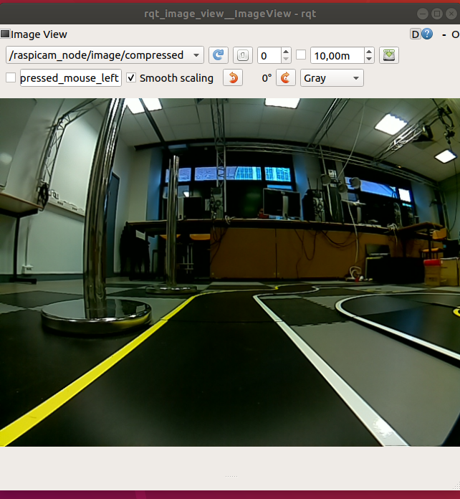
Step 1 : Image Calibration
Before Image calibration
Before Image calibration

Slide 8
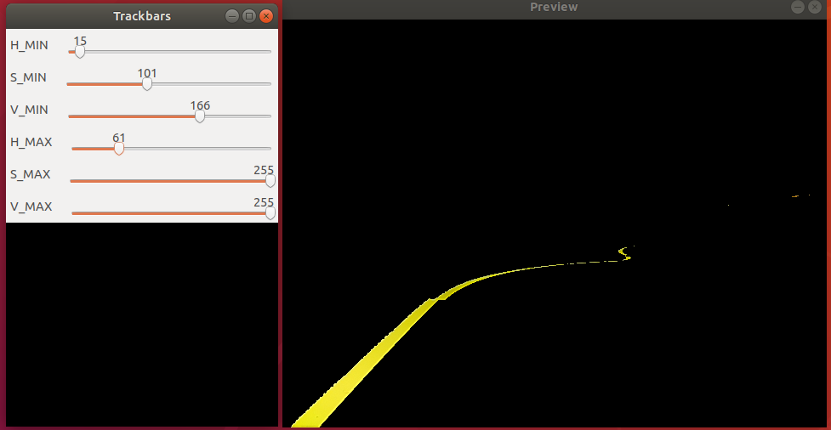
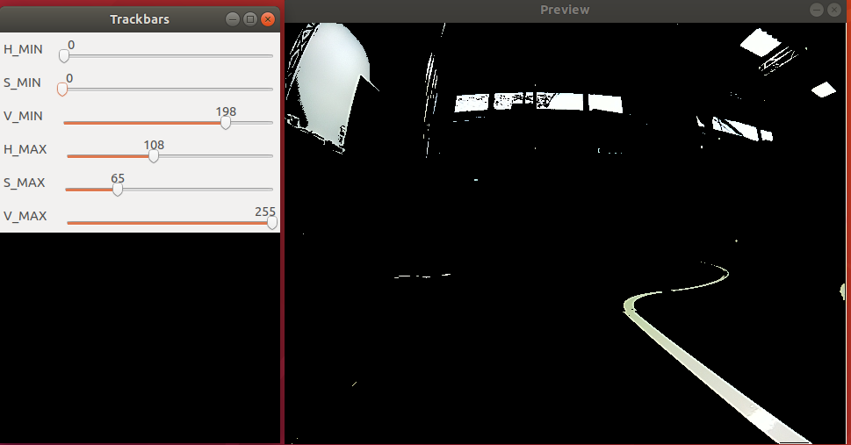
Step 2 : HSV Filtering
Yellow lane Filtering White lane Filtering

Slide 9
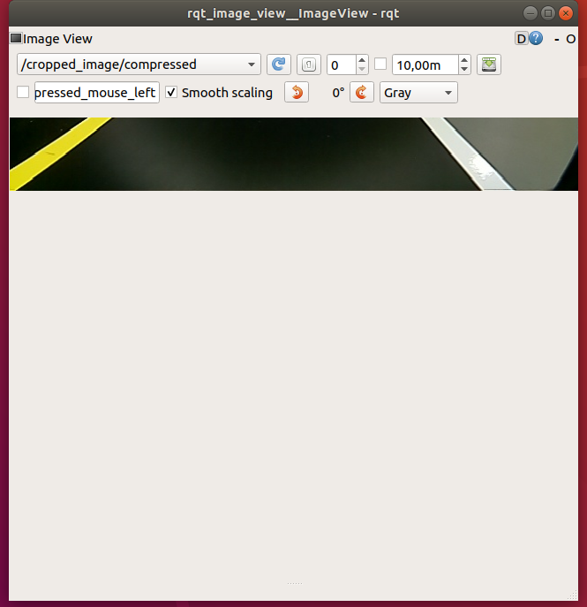
Step 2: Cropping the Image
Before Cropping After Cropping

Slide 10
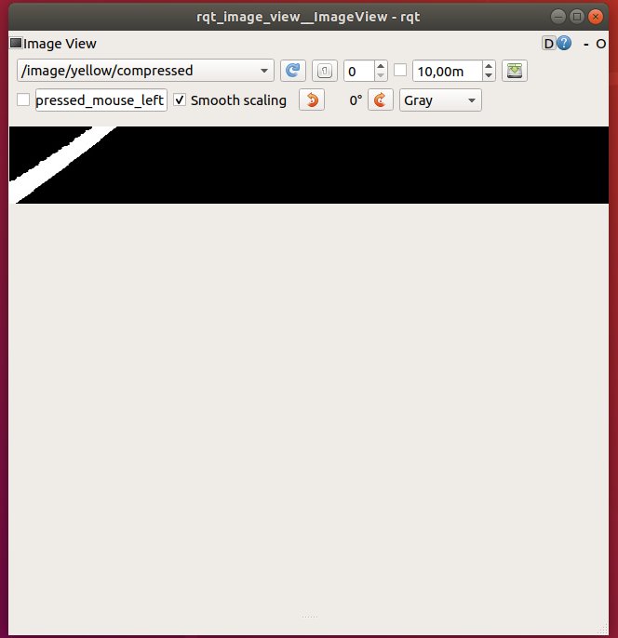
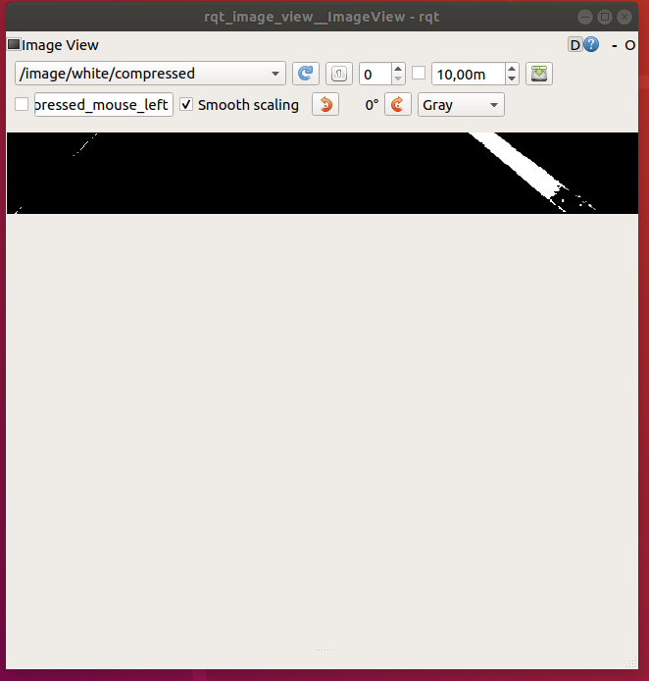
Step 2 : Cropping the Image
Yellow Lane Maked Image White Lane Masked Image

Slide 11
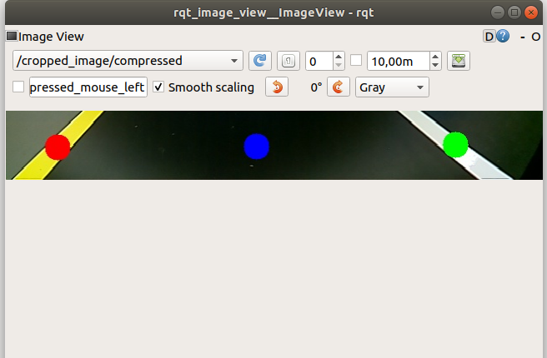
Step 3 : Control
Calculate the centroid of the lane detected in the image.
Apply PID Control with the difference b/w the centroid of the lane and center the image (along x-axis) as error.

Slide 12
Demo

Slide 13
Conclusions
Our Method uses HSV filtering for efficient filtering,image cropping to centralize the area of control, centroids of the track to control the robot’s motion.
Our Methods takes 4 to 5 minutes to complete the track. When we tried to increase the speed, the PID Parameters were also changed, which deviates the robot off the track.

Slide 14
Thank you

